Slide 1
Codeless Data Science
KNIME, is a free and open-source data analytics, reporting and integration platform.
Present By: Arief Rama Syarif

Slide 2

Hello &
Welcome
Founder
Yayasan Komunitas Open source
Data Analyst
Medco E&P Indonesia
Dosen
Universitas Nusa Mandiri
Universitas Bina Sarana Informatika

Arief Rama Syarif

Slide 3
📜
”Big data isn't about bits, it's about talent”
~ Douglas Merrill, former CIO/VP of Engineering at Google

Slide 4
📜
”We are drowning in information
but starved for knowledge”
~ John Naisbitt (1982) - Megatrends

Slide 5
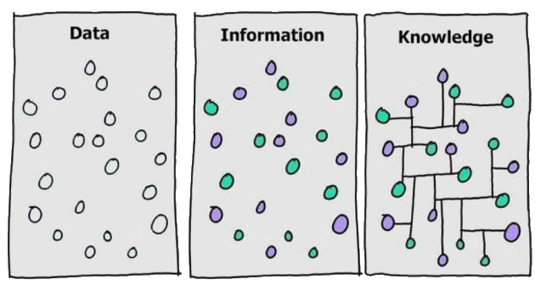

Slide 6
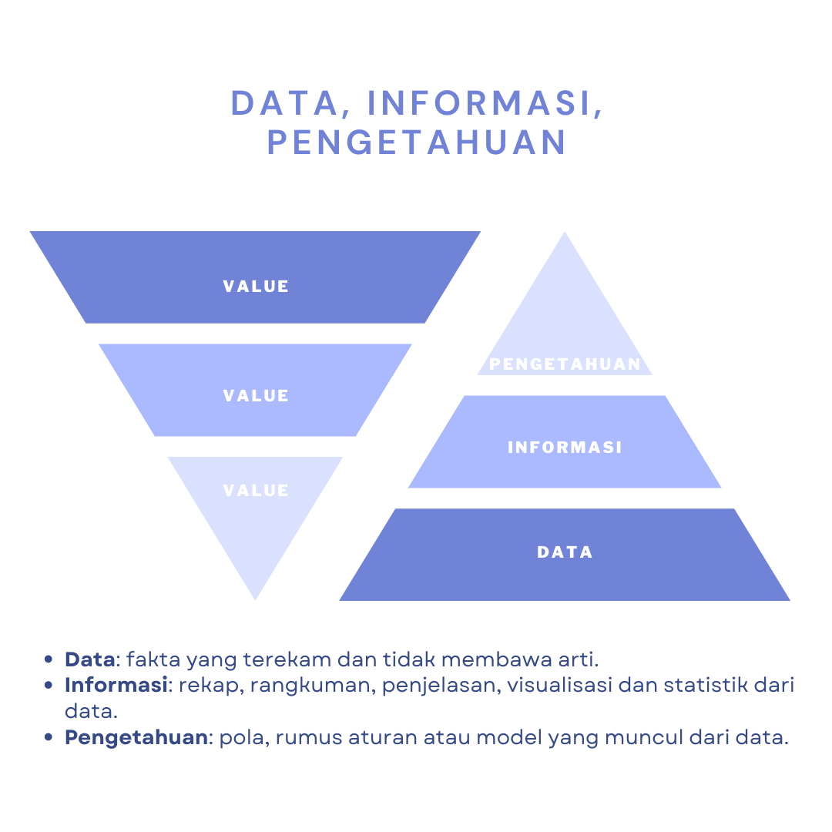

Slide 7
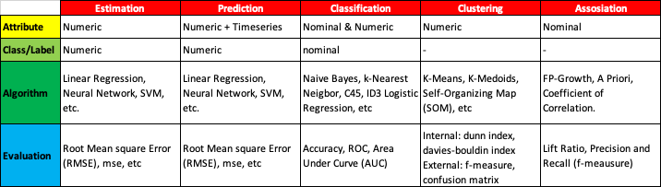
~ Daniel T Larose (2015) - Discovering knowledge in data : an introduction to data mining

Slide 8


Slide 9
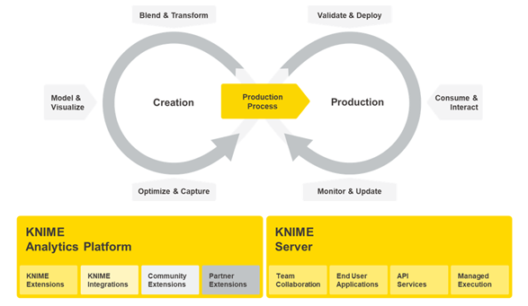

Slide 10
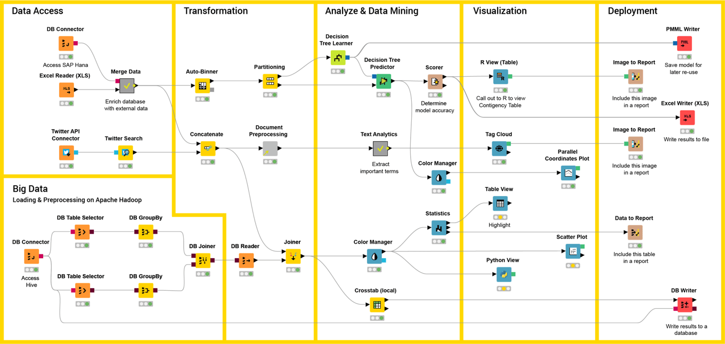

Slide 11


Slide 12

“We’re entering a new world in which data may be more important than software.”
~ Tim O’Reilly, founder, O’Reilly Media.

Slide 13

Thank you

https://www.ilc.opensuse.id

